Slide 1

IACS X
Predicting the effects of genetic perturbation in maize
Milestone 2 Presentation
Eagon, Han, Sergio, Victor

Slide 2
Project Overview

Slide 3
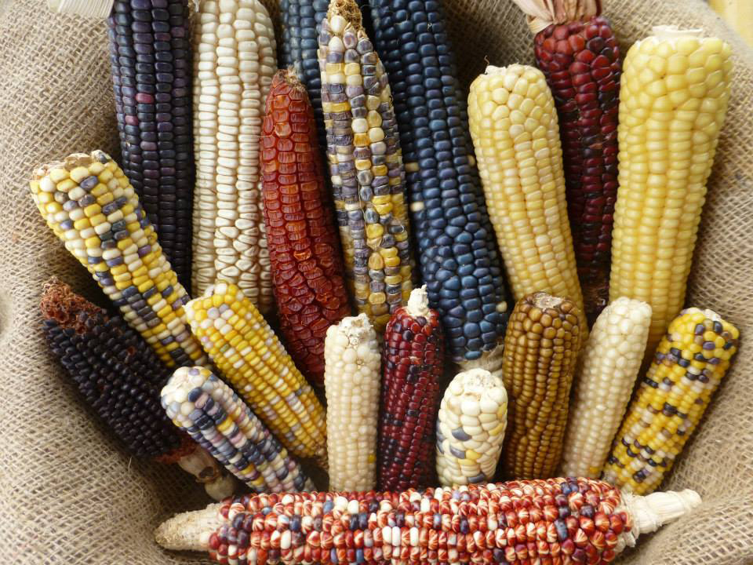
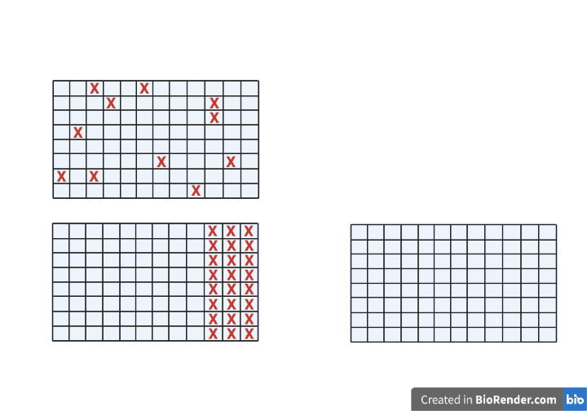
Predict what happens to the maize gene expressions when given perturbations (in the form of gene expressions of a subset of genes)
Editing effects
Reduced profiling
Our Task
40,000 Genes
?
480 Samples
Test
?

Slide 4
What are the genes that are most correlated with each gene X? Can they help us infer the gene expressions of X?
Can we detect the underlying structure in the data, so that when we cover up some of the genes, we can predict their values?
Are there certain important genes in the genome, that can be good predictors of all the other genes?
Key Questions

Slide 5
Route 1: Baseline
Regression and ensemble methods with feature selection
Simple densely connected neural network without feature selection
Route 2: Prediction Using Landmark 1000 as advanced feature selection
Route 3: Autoencoder
Dimensionality Reduction
Prediction from Latent representation
Route 4: Imputation and variational autoencoder
Route 5: Graph autoencoder with network representation
Roadmap

Slide 6
Comparison
Routes | What are the predictors | Methods of selecting/processing of predictors | Predicting on what | Methods for predicting
1. Most correlated genes | The neighboring genes of each gene, in terms of strength of pairwise correlations | GENIE3 | The expressions of each gene in the test samples | Various regressions
2. Imputation | The neighboring genes of each genes in terms of Euclidean distance | KNN | Missing gene expressions and missing genes in the leave-one-out test individual | KNN
 | Lower-dimensional space | Variational Autoencoders
3. Landmark genes | The fixed Landmark 1000 genes | Dimensionality reduction -> stable clustering -> centroids | The rest of the genes other than L1000 | Various regressions

Slide 7
Routes | What are the predictors | Methods of selecting/processing of predictors | Predicting on what | Methods for predicting
4. Graph autoencoder with network representation | Network representation of the given data to learn the relationships between node features | Uses graph autoencoders to simultaneously learn features of a network representation of expression data along with features of the expression data itself | Missing feature values (i.e. expression values) for a subset of nodes (i.e. genes) in the given network using feature values of surrounding nodes. | Imputation Prediction

Slide 8
Route 1: Prediction Using Most Correlated Genes

Slide 9
Route 1: Baseline Model
GENIE3
Using random forest regression to use all the other genes to predict the value of one target gene.
Through the process, derive pairwise gene correlations.
1000 Most Expressive Genes
Get the Coefficient of Variation of all the genes and use as features the 1000 most expressive ones
Linear Regression
Lasso Regression
Lars Regression
Random Forest Regression (Bootstrap Aggregating)
Ada Boosting Regression
Gradient Boosting
Regressions of different types

Slide 10
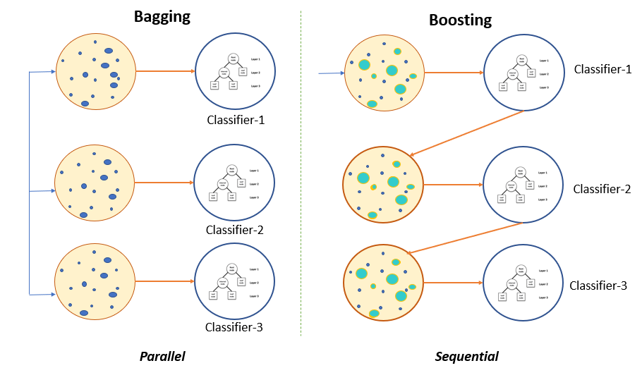
Ensemble Models

Slide 11
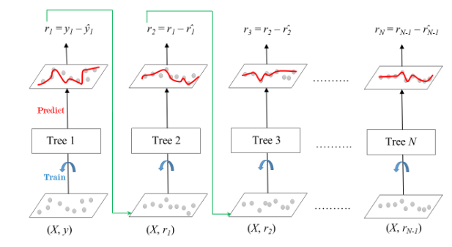
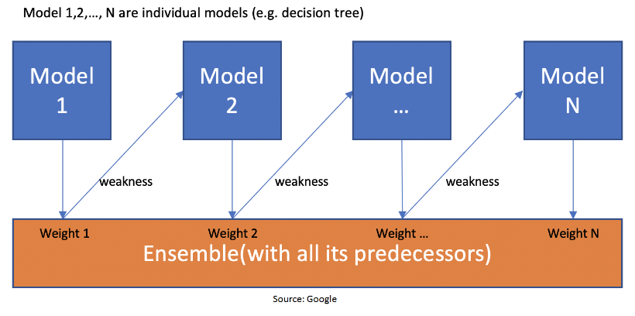
Types of Boosting models used: Ada Boosting vs Gradient Boosting
Ada Boosting
Gradient Boosting

Slide 12
Feature Selection: GENIE3 vs 1000 most Expressive Genes
GENIE3
1000 Most Expressive Genes
Calculate pairwise correlation of 4000 genes using GENIE3
For each gene, use as features the ones that have above 0.01 or more correlation
Train and run Models using a 70-30 train-test split
Calculate R^2s of the test set
Getting both standard deviation and average of expressions across all samples per gene, dividing and then sorting (Coefficient of Variation)
Take the 1000 most expressive genes and use them as features to predict the next 1000 most expressive genes
Train and run Models using a 70-30 train-test split
Calculate R^2s of the test set

Slide 13
Route 1: Baseline Models Results
 | Mean of R^2 GENIE3 | Mean of R^2 1000 Most Expressive Genes
Linear Regression | 0.4895 | -1.899e+16
Lasso Regression | 0.5061 | -27.0659
Lars Regression | 0.4889 | -7.8803
Random Forest Regression | 0.6483 | -1.6092
Ada Boosting Regression | 0.5755 | -2.3085
Gradient Boosting | 0.6285 | -4.0844
Even though the 1000 most expressive genes method allows us to use the same features for all predictions, results were significantly worse than in GENIE3

Slide 14
Route 2: Imputation of Missing Expression Data

Slide 15
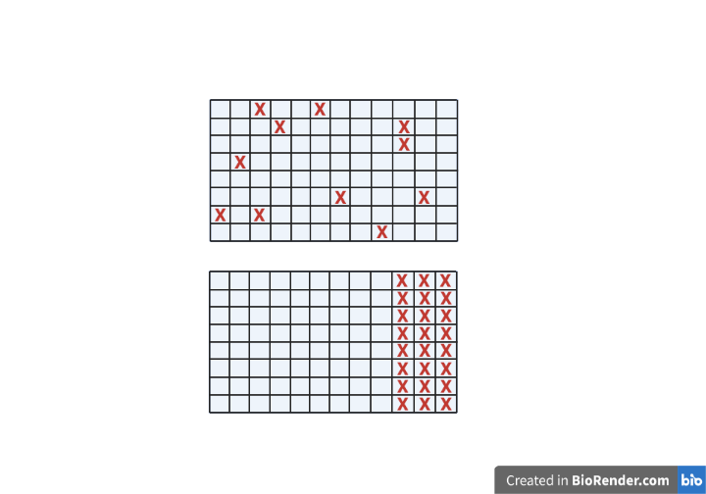
Route 2: Imputation of Missing Values
Scenario 1:
Randomly select entries to remove
5%, 10%, 50%, etc missing entries
Scenario 2:
Randomly select entire genes to remove
5%, 10%, 50%, etc missing genes
Genes
Samples
Genes
Samples

Slide 16
Route 2: Imputation of Missing Values
1: Train the model on a training set with NO missing values
2: Create predictions on a test set with missing values
Training Set
Test Set

Slide 17
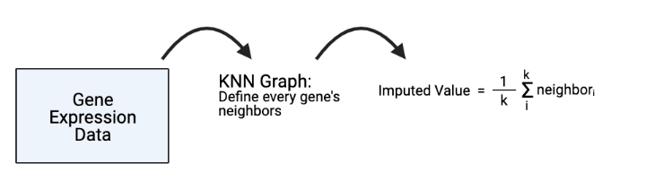
Route 2: kNN Imputation

Slide 18
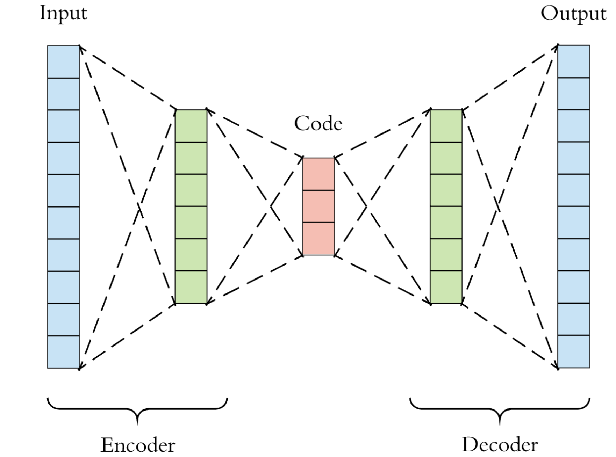
Route 2: Variational Autoencoder Imputation
But first, what’s an autoencoder?
Latent
Representation
Z
Ideally:
X ≅ X’
X
X’
Notes:
An autoencoder takes an input X, creates an encoding of X, and attempts to reconstruct X (this is the output X’) from the encoding. Autoencoders follow an encoder/decoder architecture. Ideally, the output will be identical to the input. Typically, an autoencoder creates a lower dimensional encoding of the input.

Slide 19
Route 2: Variational Autoencoder Imputation
Latent
Distribution
P(Z|X)
Ideally:
X ≅ X’
X
Sample from latent distribution
X’
Notes:
We can think of variational autoencoders as regularized autoencoders that are prevented from overfitting and whose latent spaces have good properties. Instead of creating points in a latent space, we are deriving a latent distribution for each sample.

Slide 20
Imputation Results
 | Mean - R2 value | KNN - R2 value | VAE - R2 value
Scenario 1: 5% of entries missing | 0.7231 | 0.9073 | 0.8985
Scenario 1: 10% of entries missing | 0.7235 | 0.9075 | 0.9052
Scenario 1: 50% of entries missing | 0.7223 | 0.8801 | 0.8936
Scenario 2: 5% of genes completely missing | 0.7135 | 0.9070 | 0.9034
Scenario 2: 10% of genes completely missing | 0.7206 | 0.9068 | 0.8981
Scenario 2: 50% of genes completely missing | 0.7217 | 0.8923 | 0.8941

Slide 21
Route 3: Prediction Using
Landmark 1000 Genes

Slide 22
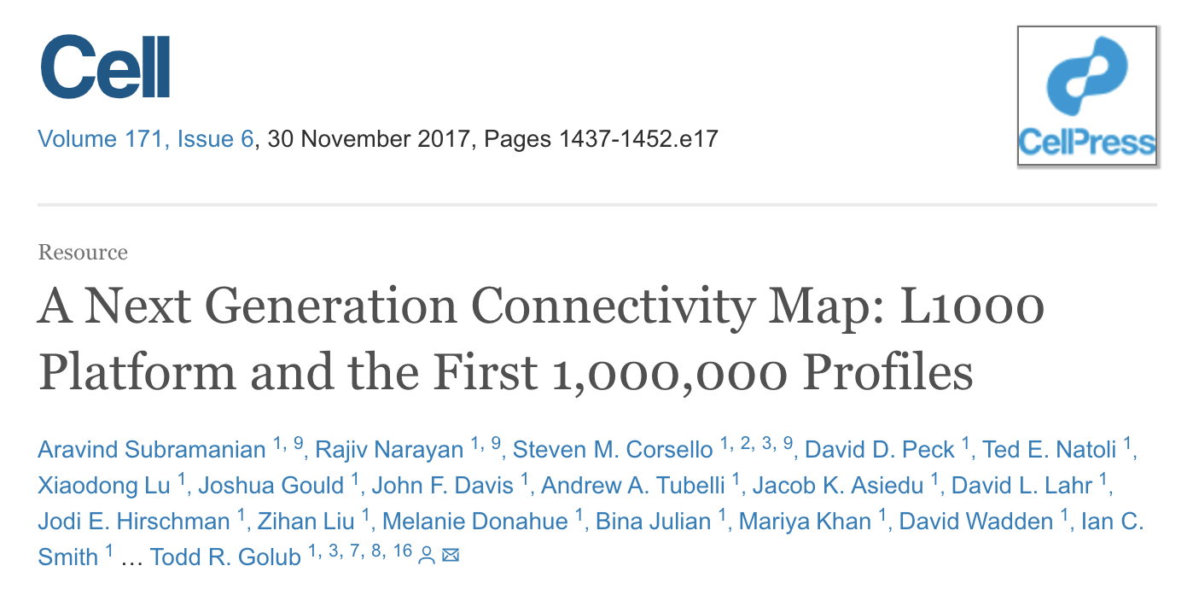
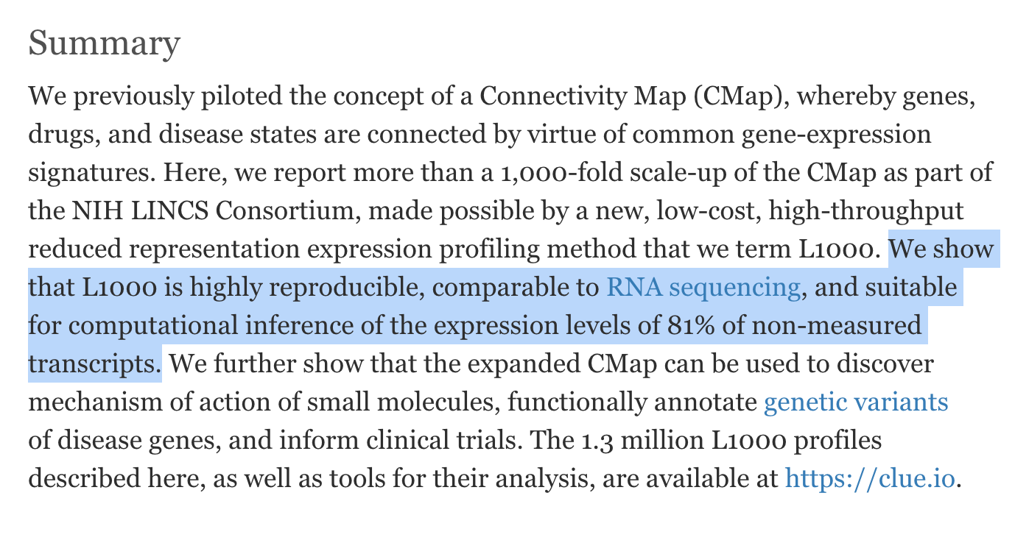
Route 3: Landmark 1000
Intuition
We can also select the most significant Landmark 1000, and use them to predict the rest.

Slide 23
Route 3: L1000
Advantage for us
Disadvantage for us
Very similar problem to what we have
Trustworthy method from an authority in the field
81% accuracy when inferring gene expressions from L1000 → not too bad even if we could get a fraction of that accuracy
Corns have 40,000+ genes while humans have 30,000+ genes
We don’t have perturbation-driven data
We have 480 samples from 25 individuals; they had 1.3 million profiles and derived 473k signatures
The code is unusable
Initially considered transfer learning, but pre-learned weights not available, too computationally expensive to train on human data

Slide 24
Route 3: L1000
Inspiration
L1000
Intuition
We want to select to most significant Landmark 1000, we want to select genes at the centers of clusters.
Methodology
Dimensionality reduction, clustering, Euclidean generalization

Slide 25
Key Components of L1000
Dimensionality reduction
PCA, t-SNE
1
Cluster analysis to cluster the genes
K-means, DBScan
2
“Bootstrapping” subsamples, repeat the above process to try to obtain different clusterings
3
Identify centroids, i.e. genes that are stably in the center of clusters
Iterative peel-off
4
Consensus matrix to see which genes are always in the same cluster, marked as Landmark 1000 genes
5
6
Using L1000 genes to predict every other gene.

Slide 26
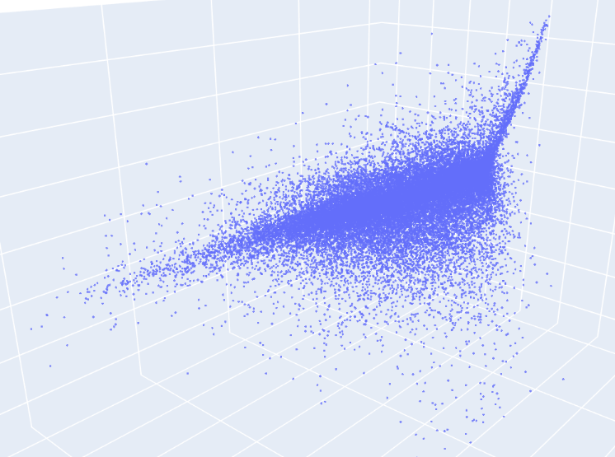
Dimensionality reduction (PCA)
1

Slide 27
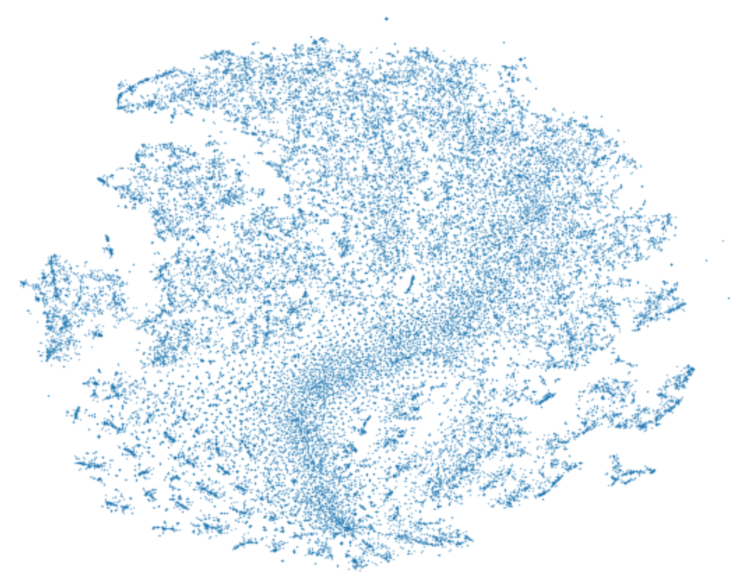
Dimensionality reduction (t-SNE)
1

Slide 28
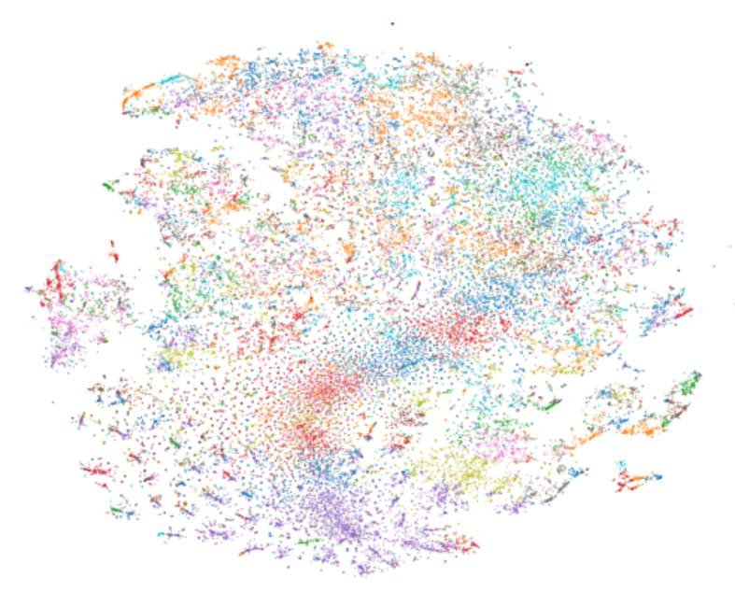
Clustering (K-means, etc.)
2

Slide 29
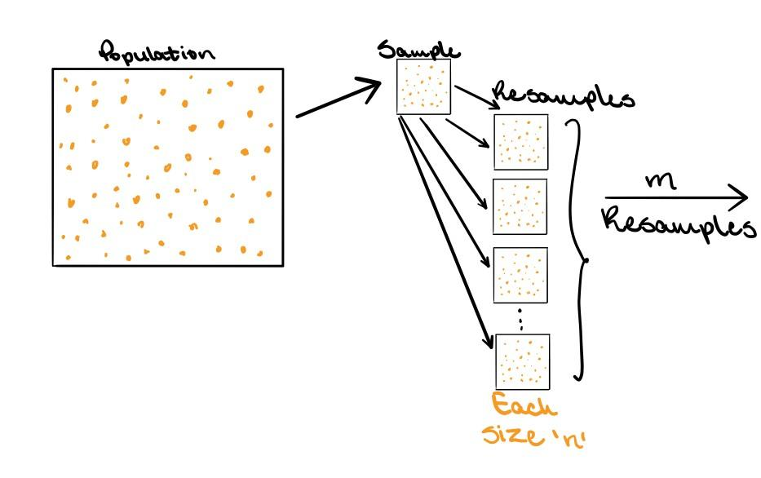
“Bootstrapping” and iterative peel-off
3
m = 100
n = 75% of total data
Partial image by Trist’n Joseph, https://towardsdatascience.com/bootstrapping-statistics-what-it-is-and-why-its-used-e2fa29577307

Slide 30
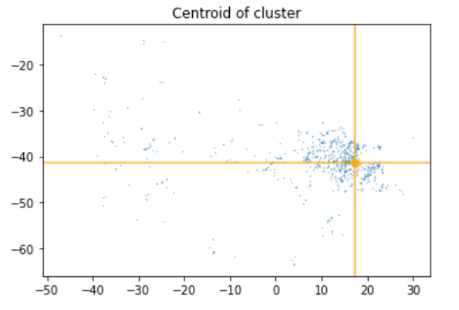
Identify centroids
4

Slide 31
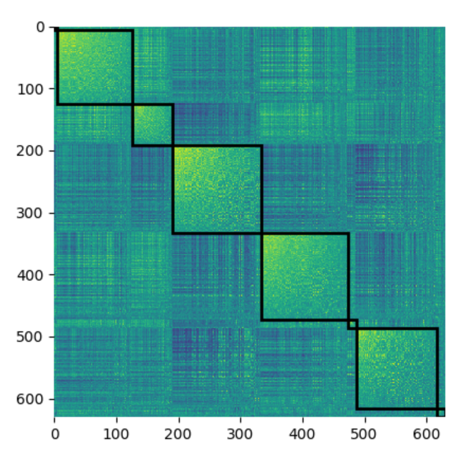
Consensus matrix to identify landmark genes
L1000 as predictive input
5
Purely for informational purposes, clustering still processing
6

Slide 32
Route 4: Graph autoencoder with network representation

Slide 33
Graph Autoencoder Roadmap:
Maize protein-protein interaction (PPI) network - Expression Data: Establish causal links between nodes in the network
1
Reconstruct a network representation of the given data (e.g. adjacency matrix, similarity matrix)
2
Graph Autoencoder Scheme: Missing expression values for a subset of nodes in the given network can be derived using surrounding nodes.
3
4
Prediction of Expression values: Imputation and Prediction
5
Complications

Slide 34
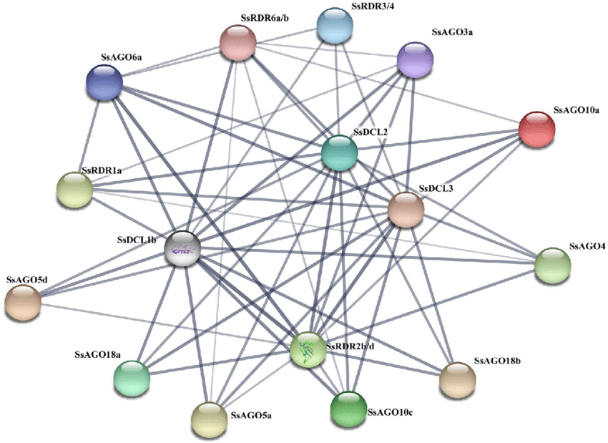
Use of PPI Network to subset the expression data
1

Slide 35
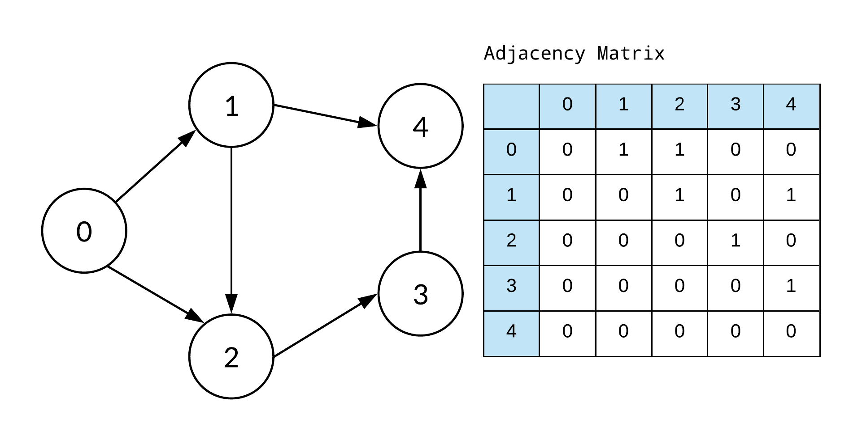
Adjacency Matrix
2

Slide 36
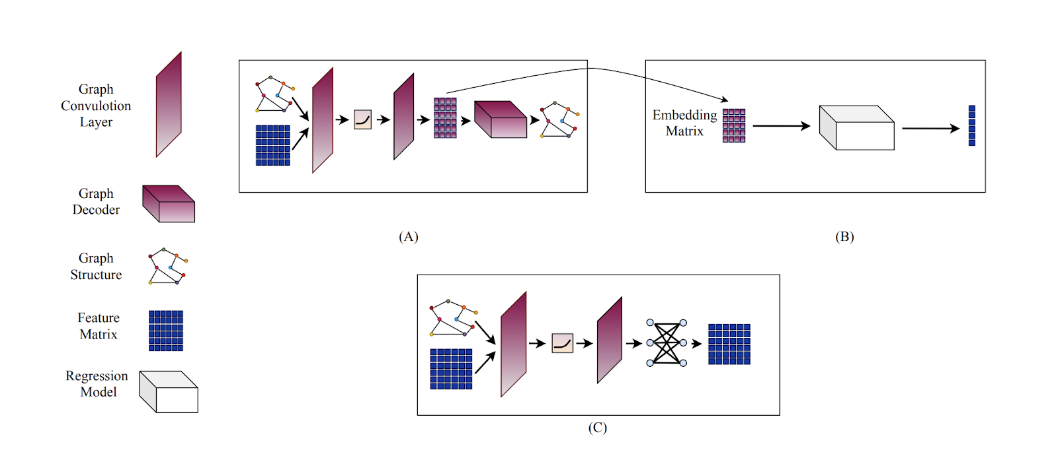
3
Graph Autoencoder Schemes
Graph Autoencoder scheme tailored to reconstruction of the adjacency of the graph
Take the Embedding matrix of graph auto-encoder and train an indirect regression task for prediction of the expression values
Proposed approach of graph feature auto-encoder for end-to-end learning of graph node features

Slide 37
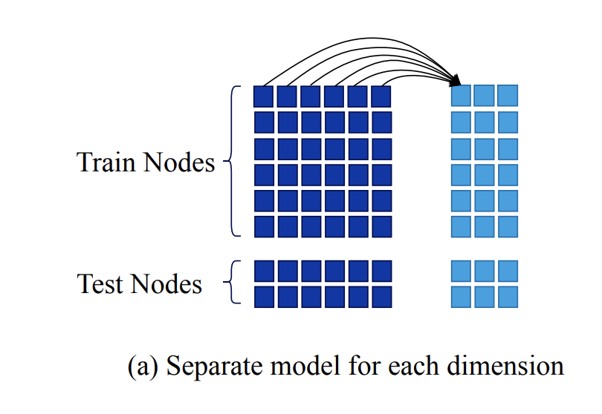
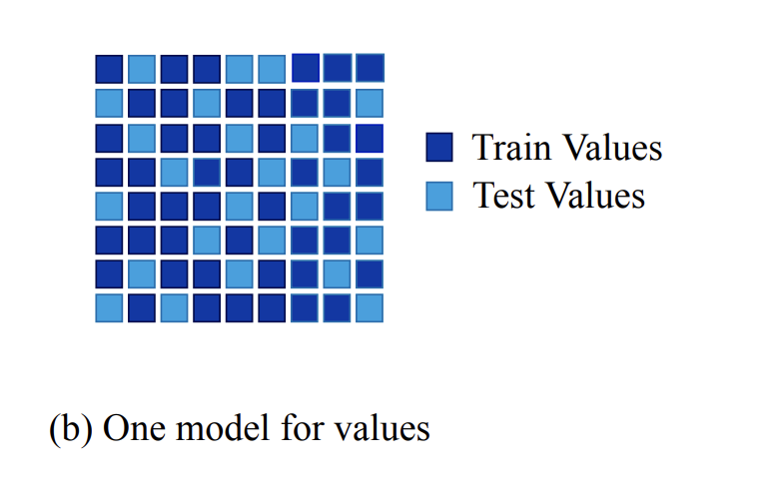
Methods of Prediction of Expression values
4
Prediction
Imputation
Each dimension of Y is predicted
using a model trained on X
A single model is used to predict all values of the feature matrix.

Slide 38
Difficulties
5

Slide 39
Future Work

Slide 40
Currently pairwise correlations derived from GENIE3 only used 4000 (10%) of the genes, need to compute for all genes -- need for parallelization and cloud computing.
1. Predicting using most correlated genes
2. Imputation of missing gene expressions
Next Steps
3. Predicting using landmark 1000 genes
Put together the pipeline
Try different combinations of tools / design options along the pipeline - dimensionality reduction, clustering, centroids, number of landmark genes.
Graph neural network
Input: raw expression values, adjacency / connectivity matrix

Slide 41

A thanks to
Inari Partners:
Karl Kremling
Ross Altman
AC297r:
Chris Tanner
Phoebe Wong
Thank You!

